Slide 1
Agentic AI Workflows for Advanced Adaptive SoC Design
2026.1 EA
Notes:
Welcome to this session on Agentic AI Workflows for Advanced Adaptive SoC Design. This is our 2026.1 Early Access release.

Slide 2
Agenda
1
Execution & Workflows
Vivado™ Execute: Closed-loop workflows (batch + GUI)
Agent Skills: Repeatable, deterministic workflows
2
Deployment & Ecosystem
Reduce OPEX: Local models, local knowledge base (KB), air-gapped solution
Vivado IDE extension in VS Code
How to get started + resources
Notes:
Today's agenda covers two main areas.
First, we go deep on execution and workflows—how the Vivado Execute capability enables closed-loop batch and GUI workflows, and how Agent Skills bring repeatable, deterministic workflows to agentic AI.
Second, we cover deployment and the ecosystem—including how to reduce operating costs with local models, a local knowledge base, and air-gapped solutions, the Vivado IDE extension for VS Code, and how to get started.

Slide 3
Agenda
1
Execution & Workflows
Vivado™ Execute: Closed-loop workflows (batch + GUI)
Agent Skills: Repeatable, deterministic workflows
2
Deployment & Ecosystem
Reduce OPEX: Local models, local knowledge base (KB), air-gapped solution
Vivado IDE extension in VS Code
How to get started + resources
Notes:
Let’s start with the execution and workflows—this is where the real value of agentic AI comes in.

Slide 4
Closed-Loop Value: From Error to Resolution
What makes this transformative for customers is not the KB alone—it is the tight integration with live AMD Vivado™ design tool session control
A typical AI-assisted debug cycle is as follows:
FPGA Engineer
AI Agent
Vivado Design Tool (Live)
Curated Knowledge Base
Run synthesis on my design
vivado_execute launch_runs synth_1
vivado_log_messages ERROR Synth 8-3352
vivado_doc_search Synth 8-3352 resolution
Result KBA with fix and Tcl command
vivado_execute apply fix
vivado_run_status synthesis complete 0 errors
Fixed the error and synthesis passed
FPGA Engineer
AI Agent
Vivado Design Tool (Live)
Curated Knowledge Base
Notes:
This slide captures the core value of the Vivado AI Assistant: it is not just the knowledge base alone—it is the tight integration between the knowledge base and a live Vivado design tool session. A typical closed-loop debug cycle works like this: the engineer says, "Run synthesis on my design".
The AI agent calls vivado_execute to launch the synthesis run. When synthesis fails, the agent reads the log using vivado_log_messages and finds error Synth 8-3352. It then calls vivado_doc_search with that error code and retrieves a knowledge base article (KBA) with the exact fix and the Tcl command. The agent applies the fix with vivado_execute, then checks run status with vivado_run_status. Synthesis completes with zero errors, and the agent reports back that the error is fixed and synthesis has passed. This entire loop—from error detection to fix verification—happens autonomously in a single agent turn.
Users can choose to review the error before applying the fix, or let the agent handle the full flow. The prompt can be structured accordingly. However, the key takeaway is that the tool is capable of handling the entire flow—from error detection to fix verification—without requiring user intervention.

Slide 5
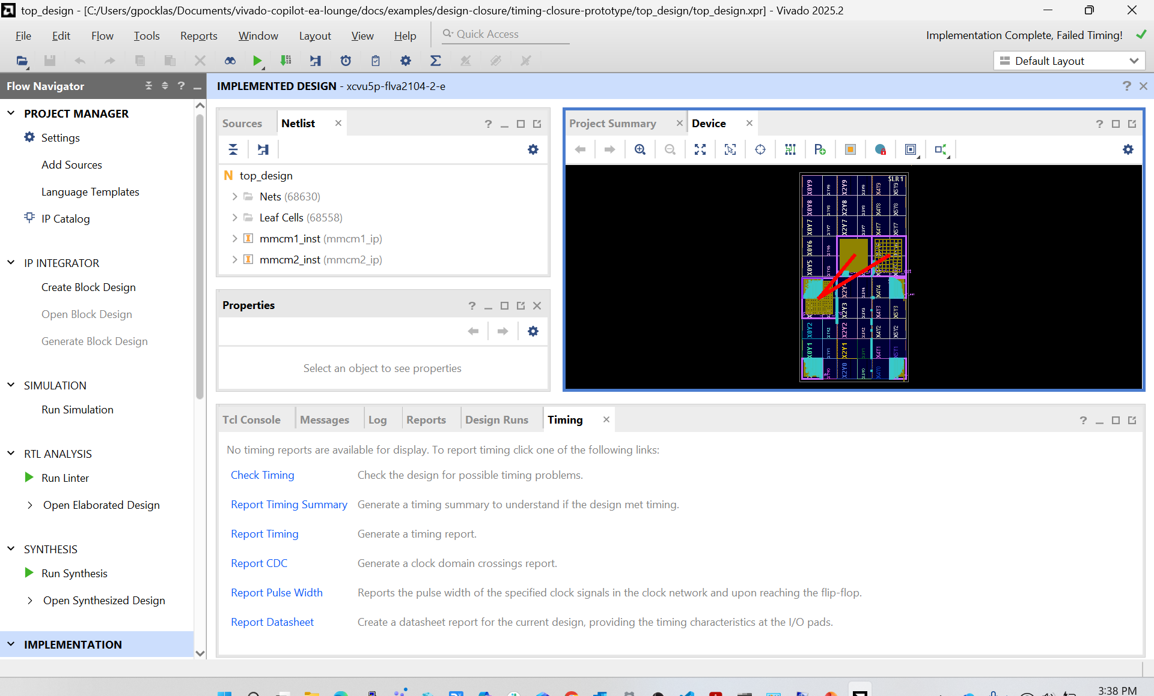
AMD Vivado MCP: Drives Vivado IDE in Batch or GUI Mode
Supports same 19 MCP tools, same AI agent, and choose the interface that fits your workflow
BATCH MODE
Headless • CI/CD Pipelines • Regression Flows
GUI MODE
Visual Debug • Interactive • Remote VNC
─── Vivado™ MCP—Tcl Batch Session ───
$ vivado_start session_type="batch"
✓ Vivado started in Tcl mode (PID 38012)
$ vivado_execute "open_project top_design.xpr"
top_design
$ vivado_execute "launch_runs synth_1"
✓ synth_1 launched
$ vivado_run status="synth_1"
synth_1: 100% Complete
$ vivado_execute "launch_runs impl_1"
✓ impl_1 launched
$ vivado_log_messages
0 Errors, 2 Warnings, 14 Info
$ vivado_execute "report_timing_summary"
WNS = 0.123ns—All timing constraints met
$ █
vivado_start gui_mode=true → Full Vivado IDE with device view, timing reports, schematic, and interactive debug—via VNC or local display
Notes:
Now that you understand the closed-loop workflow, let’s look at how the agent actually drives the Vivado IDE.
A key question from engineers is whether the MCP server supports both batch mode and GUI mode in the Vivado IDE. The answer is yes—the same 19 MCP tools and the same AI agent work in both modes.
In batch mode, which is headless and ideal for CI/CD pipelines and regression flows, the agent starts the Vivado IDE in Tcl mode, opens the project, launches synthesis and implementation, monitors status, reads logs, and checks timing—all without a display.
In GUI mode, you pass gui_mode=true to the vivado_start command and the Vivado design tool opens as a full standalone IDE. You see the chat interface in your IDE driving Tcl commands in the Vivado Tcl console in real time—making connections, running design analysis, all visible through the GUI. This is especially useful for timing analysis, device view, and floorplanning debug, where visual feedback matters.

Slide 6
Leveraging Agent Skills to Create Reliable Vivado IDE Workflow
.claude/skills/congestion-analysis/SKILL.md
---
name: congestion-analysis
version: 1.0.0
vivado: 2025.1+
duration: 3-5 minutes
difficulty: intermediate
execution: autonomous
---
# Congestion Analysis
## Mandatory Workflow
### Step 1: Generate Congestion Report
report_design_analysis \
-congestion -file congestion.rpt
### Step 2: Identify Hotspot Regions
report_design_analysis \
-congestion -min_congestion_level 5
# Parse North/South/East/West overflow
# Map hotspots to clock regions
### Step 3: Root Cause Analysis
report_utilization \
-pblocks -file util_by_region.rpt
# Correlate LUT/FF/BRAM density
# with congested regions
### Step 4: Recommend Fixes
→ Pblock floorplanning
→ SLR assignment for SSI devices
→ Synthesis retiming / restructuring
→ Phys-opt fanout replication
## Output: REPORT.md with fix commands
Autonomous
Runs with zero user intervention: the agent executes all five steps and writes the report automatically
Structured Workflow
Real Vivado™ Tcl commands in every step—no hallucinated syntax; tested against live designs
Self-validating
Design-specific fixes with real cell names, clock names, and constraints—no generic placeholders
Chainable
Skills declare upstream/downstream dependencies: Run congestion → then fanout-opt automatically
Notes:
Closed-loop execution is powerful, but consistency is critical—and that’s where Agent Skills come in. This slide shows how Agent Skills make agentic AI workflows reliable and deterministic.
LLMs do not always produce the same output, but hardware engineers need consistent, repeatable workflows. Agent Skills solve this by encoding expert-authored sequences of steps into a simple markdown file.
The example shown is a congestion analysis skill with four mandatory steps: generate the congestion report, identify hotspot regions by parsing overflow values, perform root-cause analysis by correlating LUT and BRAM density to congested clock regions, and recommend specific fixes like Pblock floorplanning, SLR assignment, synthesis retiming, or phys-opt fanout replication.
The output is a structured REPORT.md with real cell names and fix commands. Skills are autonomous, structured workflow, self-validating, and chainable. Define a skill once, share it across teams, and chain multiple skills together for complex multi-step flows.

Slide 7
AMD Vivado IDE Agent Skills—Continued Support
Clock & Timing
Design Analysis
clock-domain-crossing-review—CDC path analysis & XPM_CDC recommendations
clock-tree-topology-review—Clock architecture & MMCM/PLL topology
clock-skew-uncertainty-optimization—Skew & uncertainty budget optimization
clock-placer-failure-debug—Debug clock placement failures
clock-region-placer-failure-ep—Clock region resource exhaustion
synth-design-analysis—Post-synthesis QoR & resource assessment
opt-design-analysis—Logic optimization effectiveness review
phys-opt-design-analysis—Physical optimization analysis
route-design-analysis—Routing congestion & timing closure
congestion-analysis—Routing congestion hotspot analysis
fanout-opt—High-fanout net optimization & replication
reset-architecture-review—Reset tree & async reset verification
dfx-floorplan-review—DFX partition floorplan validation
custom-drc-ep—Custom design rule checks
Hardware Debug
Platform Specific
bd-ila-insertion—Block design ILA probe insertion
noc-compiler-failure-analysis—NoC compiler failure root-cause debug
noc-performance-monitoring—NoC traffic analysis & bandwidth tuning
pcie-link-analysis—PCIe® link training & LTSSM debug
ddr-calibration-debug—DDR4/5 calibration failure analysis
versal-timing-closure-methodology — Versal™ adaptive SoC timing closure best practices
versal-multi-run-analysis — Multi-strategy run comparison & selection
AMD is developing high-value agent skills to strengthen the Vivado™ MCP value proposition
Work in progress—more skills will be available throughout the year | Users are free to create custom skills tailored to their own designs
Notes:
Now that you’ve seen how a single skill works, let’s look at the broader skill ecosystem AMD is building.
AMD is actively developing a library of high-value agent skills for the most common FPGA workflows across four domains:
Clock and Timing includes skills for CDC path analysis with XPM_CDC recommendations, clock tree topology review, clock skew optimization, and clock placement failure debug.
Design Analysis includes skills for post-synthesis and post-implementation QoR, congestion analysis, high-fanout net optimization, reset tree verification, DFX floorplan validation, and custom DRC checks.
Hardware Debug includes skills for ILA probe insertion, NoC compiler failure analysis, NoC performance monitoring, PCIe link training debug, and DDR calibration failure analysis.
Platform-specific skills include Versal timing closure methodology and multi-run strategy comparison.
These skills are work in progress and more will be released throughout the year. Users are also free to write custom skills—skills are plain-text markdown files that any engineer can author and share.

Slide 8
Agenda
1
Execution & Workflows
Vivado™ Execute: Closed-loop workflows (batch + GUI)
Agent Skills: Repeatable, deterministic workflows
2
Deployment & Ecosystem
Reduce OPEX: Local models, local knowledge base (KB), air-gapped solution
Vivado IDE extension in VS Code
How to get started + resources
Notes:
So far, you’ve focused on execution and workflows. Now let’s shift to the second part of the agenda—deployment and ecosystem.

Slide 9
Recognizing the Importance of Reducing OPEX
Full Local Inference
Qwen 3.5 35B on AMD silicon via Lemonade Server¹—no API keys, no subscriptions
AMD Strix Halo Mini PC—Fully Local, Zero Cloud
OpenCode CLI
User Interface
Qwen 3.5 35B
Lemonade Server Local Inference
AMD Vivado™ MCP Server
19 Tools Local Deployment
Same MCP Tools
The Vivado MCP toolset interface remains consistent across local and cloud deployments
Modular Stack
Each component independently deployable—swap LLM, upgrade KB, or scale as needed
Zero Cloud Cost Air-Gap Capable
Vivado IDE 2025.2
Local Installation
Knowledge Base
Docker • localhost
Secure by Design
All data stays on-premises—ideal for defense, government, and IP-sensitive environments
1. Lemonade is a local AI server that runs models on your own hardware and exposes an OpenAI-compatible API
Notes:
We recognize that enterprise customers, especially in defense and government, need to minimize cloud costs and keep all data on-premises.
Our architecture supports a fully local, air-gapped deployment. We validated this internally using an AMD Strix Halo Mini PC with 128 GB RAM and an integrated GPU, running the Qwen 3.5 35-billion parameter model via OpenCode CLI and Lemonade Server for local inference.
The MCP server with all 19 tools was deployed locally, and even the knowledge base Docker container ran on localhost. No API keys, no cloud subscriptions, no data leaving the machine.
The modular architecture also allows each component to be updated independently, making the system flexible and future-ready. It also enables cost-performance optimization. While local models may need more iterations than frontier models today, this will improve as open-source models advance. Overall, local deployment offers a secure and cost-efficient approach for agentic AI workflows.

Slide 10
Setting Expectations: Local LLM vs. Frontier Models
Dimension | Local LLM (On-Prem) | Frontier Model (Cloud)
Strength | Great for documentation Q&A, tool execution, repeatable workflows | Best for deep reasoning, longer code generation, fewer iterations
Tunning for Vivado™ MCP Parameters | Needed for context window management, token consumption, and prompt sizing | Not needed
Cost | Fixed infrastructure cost; no per-token/API fees | Usage-based (tokens, requests, subscriptions)
Data & Privacy | Prompts, designs, and logs stay on-prem | Data leaves the network (subject to provider policies)
Deployment | Can run offline/air-gapped | Requires network/service access
MCP architecture is LLM-agnostic
Ensuring the stack works today with local models and improves as open-source LLMs advance
Notes:
However, local LLMs are not yet as capable as frontier models like Claude or GPT. Complex multi-step reasoning and code generation may require more iterations and produce less precise results.
You may also need to tune MCP server parameters to manage context window size and reduce token consumption. The architecture is modular and LLM-agnostic—you can swap the LLM or scale to cloud frontier models as needed.
We see local deployment as an important future direction for customers with strict operative expenses and security constraints as local LLMs can run offline in air-gapped environment whereas frontier models require a network access.
MCP architecture is LLM-agnostic, ensuring the stack works today with local models and improves as open-source LLMs advance.

Slide 11
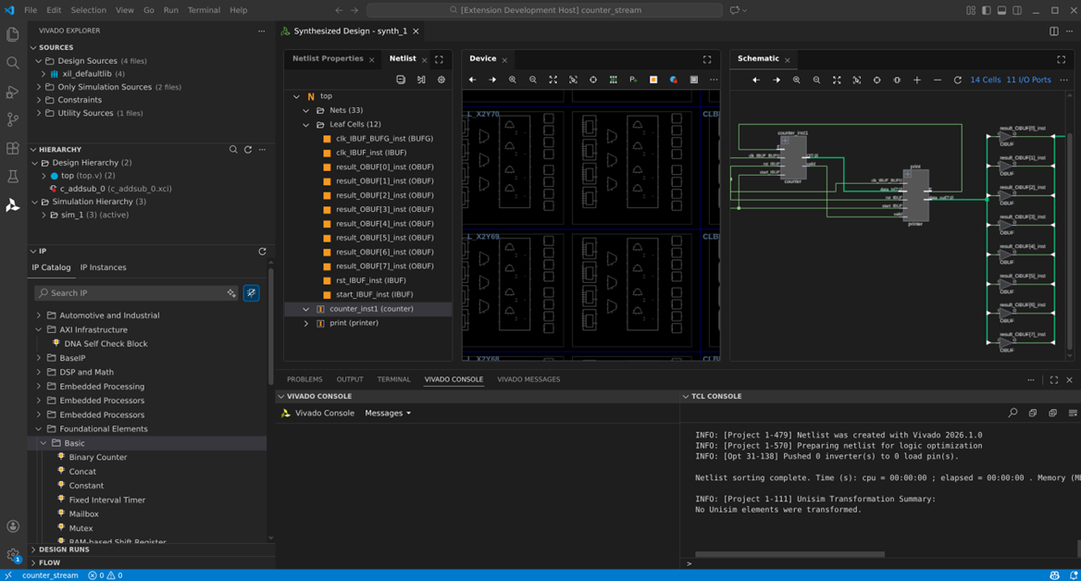
AMD Vivado Design Suite Extension for VS Code Vivado™ Tool Experience Inside Your IDE
Design Entry & Management
IP Catalog browser—search, configure, generate
IP Integrator block design visualization
Project and non-project mode support
Design Visualization
Schematic viewer for RTL & synthesized netlists
Device view with floorplanning
Interactive signal tracing & cross-probing
AI-powered Features
Ask AI—natural language design queries
MCP-backed Tcl terminal for smart execution
Context-aware suggestions from open design
Build & Run
Synthesis & implementation run management
Real-time progress and log monitoring
Timing summary & utilization at a glance
Early Access (EA):
The Vivado IDE Extension for VS Code is currently available to early access customers only
Notes:
Today, users have two separate UIs: their IDE or CLI and the standalone Vivado GUI running in parallel. To unify this experience, AMD is developing the Vivado tool extension for VS Code, which brings key Vivado design tool UI elements directly into the VS Code interface.
Features include the IP Catalog browser for search, configure, and generate; IP Integrator block-design visualization; schematic viewer for RTL and synthesized netlists; device view with floorplanning; and interactive signal tracing and cross-probing.
AI-powered features include the Ask AI panel for natural-language design queries, an MCP-backed Tcl terminal for smart execution, and context-aware suggestions from the open design.
Build and run management is also integrated—synthesis and implementation, real-time log monitoring, and timing summary at a glance. This extension is a work in progress and is not part of the first EA release, but it represents our vision for a unified, one-stop agentic AI experience inside VS Code.

Slide 12
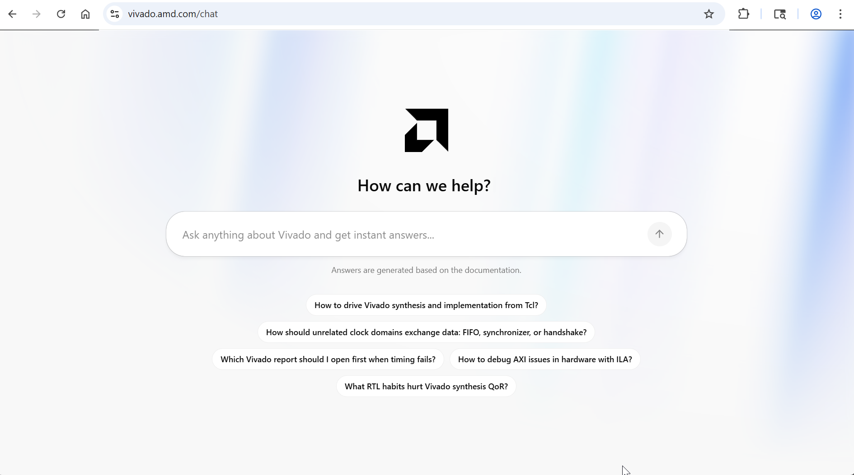
A One-Stop Shop for AMD Vivado IDE Queries
Access the AMD knowledge base via a web portal: vivado.amd.com/chat
Connects to the same AMD network-hosted documentation database
Delivers retrieval-augmented generation (RAG) powered, citation-backed outputs
Notes:
In addition to the MCP server, you can access the AMD knowledge base through a simple web portal.
Go to vivado.amd.com/chat and ask natural language questions—no Vivado installation or IDE setup required. This is ideal for system architects evaluating devices, comparing IPs, or exploring design options before they have a project open in Vivado.
The web portal connects to the same AMD network-hosted documentation database, ensuring you receive the same retrieval-augmented generation (RAG) powered responses—with citations—as the MCP server. It is a one-stop shop for any Vivado IDE or AMD device-related question, accessible from any browser.

Slide 13
Get Started Today
Request Access to the EA Secure Site
AMD Vivado™ Adaptive SoC & FPGA Tools MCP Server
Install on Windows® & Linux®—works with any MCP-capable IDE or CLI
Agent Skills
Pre-built AMD skills for common FPGA workflows—ready to use out of the box
Example Designs
Reference projects to run and validate your agentic AI setup end-to-end
Dedicated AMD Engineering Support
Direct access to AMD engineers for onboarding, debugging, and feedback
Contact Your FAE to Participate in Early Access Program
Access Request Link: Vivado AI Assistant Early Access Secure Site
Access is limited to Early Access (EA) customers
Notes:
With the workflows and ecosystem in place, let’s look at how you can get started.
Getting started is straightforward through the early access program. Through the EA secure site, customers and field engineers get access to four key resources:
The AMD Vivado MCP Server—installable on Windows and Linux, compatible with any MCP-capable IDE or CLI;
Pre-built Agent Skills for common FPGA workflows, ready to use out of the box;
Example Designs—reference projects to run and validate your agentic AI setup end-to-end; and
Dedicated AMD Engineering Support—direct access to AMD engineers for onboarding, debugging, and feedback.
To get access, contact your FAE to participate in the Early Access Program. Access is limited to approved EA customers.

Slide 14
Next Steps and Additional Resources
1
Request direct access to lounge:
https://account.amd.com/en/member/vivado-ai-assistant-ea.html
Follow instructions to access private forum
2
To share your feedback use:
EA Forum or email vivado_ai_assistant@amd.com.
Notes:
Here are the specific next steps for everyone on this call.
Request direct access to the EA lounge at the provided link. Once approved, follow instructions in the lounge to join the private support forum.

Slide 15
Summary
01
AMD Vivado™ AI Assistant boosts design productivity through:
Automated, agent-driven workflows for error detection, fixing, and validation
Scalable, repeatable FPGA design via Agent Skills
Flexible deployment (local, cloud, air-gapped)
Seamless integration with Vivado tools
Real-time, context-aware insights for faster debugging and optimization
Notes:
The AMD Vivado AI Assistant enhances design productivity with intelligent, agent-driven workflows that automatically detect, fix, and validate issues end-to-end. It enables consistent and scalable FPGA design through reusable Agent Skills, while offering flexible deployment options across local, cloud, and air-gapped environments to meet performance, cost, and security needs. Seamlessly integrated with Vivado tools, it delivers real-time, context-aware insights that accelerate debugging and optimization, ensuring a more efficient and unified design experience.

Slide 16
Disclaimer and Attributions
The information contained herein is for informational purposes only and is subject to change without notice. While every precaution has been taken in the preparation of this document, it may contain technical inaccuracies, omissions and typographical errors, and AMD is under no obligation to update or otherwise correct this information. Advanced Micro Devices, Inc. makes no representations or warranties with respect to the accuracy or completeness of the contents of this document, and assumes no liability of any kind, including the implied warranties of noninfringement, merchantability or fitness for particular purposes, with respect to the operation or use of AMD hardware, software or other products described herein. No license, including implied or arising by estoppel, to any intellectual property rights is granted by this document. Terms and limitations applicable to the purchase or use of AMD products are as set forth in a signed agreement between the parties or in AMD's Standard Terms and Conditions of Sale. GD-18u © 2026 Advanced Micro Devices, Inc. All rights reserved. AMD, the AMD Arrow logo, Spartan, UltraScale+, Versal, Vitis, Vivado, Zynq, and combinations thereof are trademarks of Advanced Micro Devices, Inc. Docker and the Docker logo are trademarks or registered trademarks of Docker, Inc. Linux is the registered trademark of Linus Torvalds in the U.S. and other countries. PCIe is a registered trademark of PCI-SIG Corporation. Windows is a registered trademark of Microsoft Corporation in the US and/or other countries. Other product names used in this publication are for identification purposes only and may be trademarks of their respective owners. Certain AMD technologies may require third-party enablement or activation. Supported features may vary by operating system. Please confirm with the system manufacturer for specific features. No technology or product can be completely secure.

Slide 17
Notes:
Thank you for joining this session on Agentic AI Workflows for Advanced Adaptive SoC Design.
For questions, reach out through the Early Access forum or the #vivado_general Slack channel.

